Slide 1


Introduction to Programming Paradigms and Core Language Design Issues

Slide 2
Introduction to different programming paradigms
Paradigm can be termed as method to solve some problem or do some task. Programming paradigm is an approach to solve problem using some programming language
It is also a method to solve a problem using tools and techniques that are available to us following some approach.
There are lots for programming language that are known but all of them need to follow some strategy when they are implemented and this methodology/strategy is paradigms

Slide 3
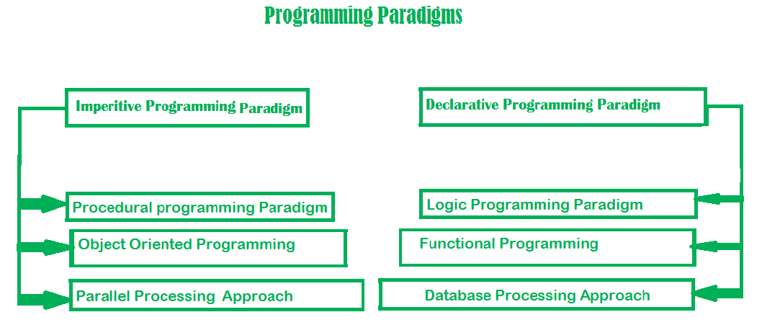

Slide 4
Imperative programming paradigm
It is one of the oldest programming paradigm.
It features close relation to machine architecture.
It is based on Von Neumann architecture.
It works by changing the program state through assignment statements. It performs step by step task by changing state.
The main focus is on how to achieve the goal.
The paradigm consist of several statements and after execution of all the result is stored.

Slide 5
Imperative programming paradigm
Advantage:
Very simple to implement
It contains loops, variables etc.
Disadvantage:
Complex problem cannot be solved
Less efficient and less productive
Parallel programming is not possible

Slide 6
Imperative programming paradigm
Imperative programming is divided into three broad categories: Procedural, OOP and parallel processing
Procedural programming paradigm –
This paradigm emphasizes on procedure in terms of under lying machine model.
There is no difference in between procedural and imperative approach.
It has the ability to reuse the code and it was boon at that time when it was in use because of its reusability.
E.g. C language

Slide 7
Imperative programming paradigm
#include <iostream>
using namespace std;
int main()
{
int i, fact = 1, num;
cout << "Enter any Number: ";
cin >> number;
for (i = 1; i <= num; i++) {
fact = fact * i;
}
cout << "Factorial of " << num << " is: " << fact << endl;
return 0;
}

Slide 8
Imperative programming paradigm
Object oriented programming –
The program is written as a collection of classes and object which are meant for communication.
The smallest and basic entity is object and all kind of computation is performed on the objects only.
More emphasis is on data rather procedure.
It can handle almost all kind of real life problems which are today in scenario.
Advantages:
Data security
Inheritance
Code reusability
Flexible and abstraction is also present

Slide 9
Imperative programming paradigm
Parallel processing approach –
Parallel processing is the processing of program instructions by dividing them among multiple processors.
A parallel processing system posses many numbers of processor with the objective of running a program in less time by dividing them.
This approach seems to be like divide and conquer

Slide 10
Declarative programming paradigm:
It is divided as Logic, Functional, Database.
In computer science the declarative programming is a style of building programs that expresses logic of computation without talking about its control flow.
It often considers programs as theories of some logic.
It may simplify writing parallel programs.
The focus is on what needs to be done rather how it should be done basically emphasize on what code code is actually doing.
It just declare the result we want rather how it has be produced.
This is the only difference between imperative (how to do) and declarative (what to do) programming paradigms.

Slide 11
Declarative programming paradigm
Logic programming paradigms – It can be termed as abstract model of computation.
It would solve logical problems like puzzles, series etc.
In logic programming we have a knowledge base which we know before and along with the question and knowledge base which is given to machine, it produces result.
In normal programming languages, such concept of knowledge base is not available but while using the concept of artificial intelligence, machine learning we have some models like Perception model which is using the same mechanism.
In logical programming the main emphasize is on knowledge base and the problem. The execution of the program is very much like proof of mathematical statement, e.g., Prolog

Slide 12
Declarative programming paradigm
Functional programming paradigms – The functional programming paradigms has its roots in mathematics and it is language independent.
The key principal of this paradigms is the execution of series of mathematical functions.
The central model for the abstraction is the function which are meant for some specific computation and not the data structure.
Data are loosely coupled to functions.
The function hide their implementation. Function can be replaced with their values without changing the meaning of the program. Some of the languages like perl, javascript mostly uses this paradigm.

Slide 13
Declarative programming paradigm
Database/Data driven programming approach – This programming methodology is based on data and its movement.
Program statements are defined by data rather than hard-coding a series of steps.
A database program is the heart of a business information system and provides file creation, data entry, update, query and reporting functions.
There are several programming languages that are developed mostly for database application.
For example SQL. It is applied to streams of structured data, for filtering, transforming, aggregating (such as computing statistics), or calling other programs. So it has its own wide application.

Slide 14
Names, Scope, Memory, and Binding

Slide 15
Name:
It is divided as Logic, Functional, Database.
In computer science the declarative programming is a style of building programs that expresses logic of computation without talking about its control flow.
It often considers programs as theories of some logic.
It may simplify writing parallel programs.
The focus is on what needs to be done rather how it should be done basically emphasize on what code code is actually doing.
It just declare the result we want rather how it has be produced.
This is the only difference between imperative (how to do) and declarative (what to do) programming paradigms.

Slide 16
Binding(association between name and object)
Binding Time is the point at which a binding is created
language design time
program structure, possible type, control flow structure(i.e. if,if else ,for….)
Constructors,pointers….
language implementation time
I/O, arithmetic overflow, stack size, type equality (if unspecified in design)
Eg int…what is size of int,float..what is precision of float
program writing time
algorithms, names
compile time
Time taken to convert HLL to ML
link time
different module will be compiled separately and finally linked together at link time.
load time
Once linked, file has to be loaded in memory for execution.

Slide 17
Binding
Implementation decisions (continued):
run time(time for running the program )
value/variable bindings, sizes of strings
program start-up time
module entry time
elaboration time (point a which a declaration is first "seen")
procedure entry time
block entry time
statement execution time

Slide 18
BASIS FOR COMPARISON | STATIC BINDING | DYNAMIC BINDING
Event Occurrence | Events occur at compile time are "Static Binding". | Events occur at run time are "Dynamic Binding".
Information | All information needed to call a function is known at compile time. | All information need to call a function come to know at run time.
Advantage | Efficiency. | Flexibility.
Time | Fast execution. | Slow execution.
Alternate name | Early Binding. | Late Binding.
Example | Overloaded function call, overloaded operators. | Virtual function in C++, overridden methods in java.

Slide 19
Object lifetime
Binding lifetime:
Time between creation and destruction of name to object binding
Object's lifetime:
Time b/w creation and destruction of object
Name can be destroyed but object is still in the memory
Dangling reference:
Binding to object that no longer live

Slide 20
Lifetime and Storage Management
Key events
creation of objects
creation of bindings
references to variables (which use bindings)
(temporary) deactivation of bindings
reactivation of bindings
destruction of bindings
destruction of objects
The period of time from creation to destruction is called the LIFETIME of a binding
If object outlives binding it's garbage
If binding outlives object it's a dangling reference
The textual region of the program in which the binding is active is its scope

Slide 21
Storage Management
Static:
Variables whose value will be same throughout the program is called static variable eg.global variables in heap
Stack:
based on LIFO order Eg, subroutine calls i.e when function is called, it gets stored in form of LIFO
Heap:
arbitrary time data, data which comes at run time is stored in heap

Slide 22
Lifetime and Storage Management
Storage Allocation mechanisms(how the objects are stored in the memory)
Static
Given absolute address retained throughout program exection e.g global variables
Stack
Allocated and reallocated in LIFO order
Applicable for subroutine…function call
Heap(most costliest aloocation)
Allocated and reallocated at arbiter times
Static allocation for
code
globals
static or own variables
explicit constants (including strings, sets, etc)
scalars may be stored in the instructions

Slide 23
Static Allocation
Objects whose value do not change during Program execution
Statically allocated objects
Global variables
Instruction for machine language translation
Local variables that retain values b/w invocation
Numeric and string valued constants literals
A=B/14-7
Printf(“hello, world\n”)
Debugging,dynamictype-checkinh,garbage collection, exception handling

Slide 24
Static Allocation
Named constant (e.g.const keyword)
Value is determined at compile time
Named constants with constant literals are called manifest constants or compile-time constants
Compile time
Syntax checking
Elaboration time
Translation of HLL to MLL
Run time
Execution of object code(MLL)

Slide 25
Static Allocation
Elaboration time constant:
Values may depend on other values not known until run time
#define is example in c
C# provide both option
Keyword-manifest constant
Read-only-elaboration constant

Slide 26
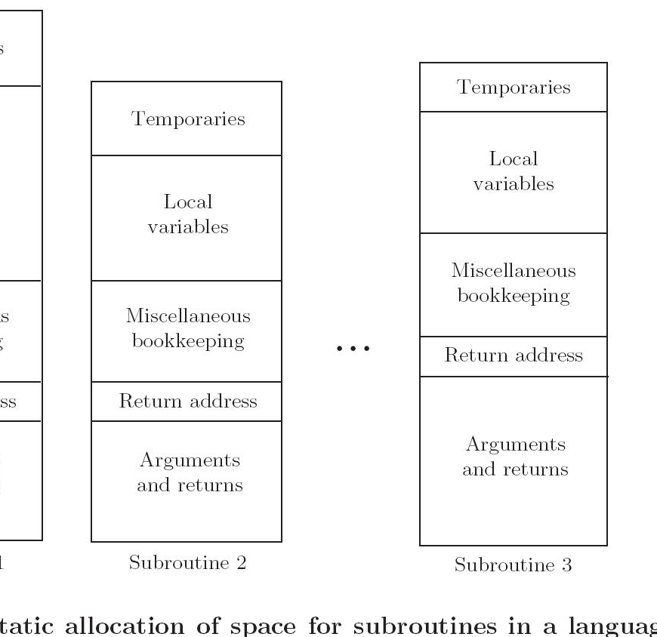
Lifetime and Storage Management

Slide 27
Stack based allocation
All subroutines are stack allocated
When a function is called, invokes multiple invocation
To avoid memory wasting,stack is used to allocated function

Slide 28
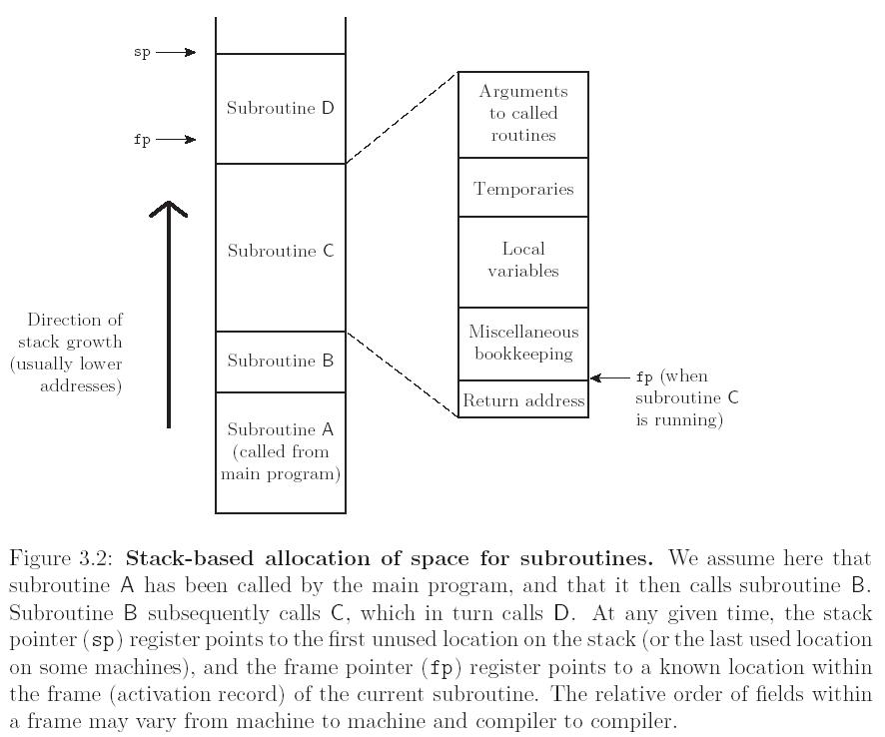
Stack based allocation

Slide 29
Lifetime and Storage Management
Central stack for subroutine
Arguments to routines
parameters
local variables
Temporaries(temporary variables)
Book keeping(additional information is stored)
Return address(after subroutine is done, where it goes)

Slide 30
Lifetime and Storage Management
Maintenance of stack is done by subroutine calling sequence, prologue and epilogue
Calling sequence:
Code executed by caller immediately before and after the call
Combined operations of caller, prologue and epilogue
Prologue
Code executed at the beginning
Epilogue:
Code executed at the end

Slide 31
Memory Management Heap
More unstructured
Region of memory where sub blocks are allocated and deallocated dynamically
Allocation and deallocation may happen in arbitrary order
Memory may become fragmented
Need for garbage collection
We will describe garbage collection algorithms later
Heap Management
Often managed with a single linked list – the free list – of blocks not in use
First Fit?
Best Fit? (smallest block large enough to handle request)

Slide 32
Scope Rules
With STATIC (LEXICAL) SCOPE RULES, a scope is defined in terms of the physical (lexical) structure of the program
The determination of scopes can be made by the compiler
All bindings for identifiers can be resolved by examining the program
Typically, we choose the most recent, active binding made at compile time
Most compiled languages, C++ and Java included, employ static scope rules

Slide 33
Scope Rules
Note that the bindings created in a subroutine are destroyed at subroutine exit
Obvious consequence when you understand how stack frames are allocated and deallocated
The modules of Modula, Ada, etc., give you closed scopes without the limited lifetime
Bindings to variables declared in a module are inactive outside the module, not destroyed
The same sort of effect can be achieved in many languages with own (Algol term) or static (C term) variables

Slide 34
Scope Rules
The key idea in static scope rules is that bindings are defined by the physical (lexical) structure of the program.
With dynamic scope rules, bindings depend on the current state of program execution
They cannot always be resolved by examining the program because they are dependent on calling sequences
To resolve a reference, we use the most recent, active binding made at run time

Slide 35
Binding of Referencing Environments
Accessing variables with dynamic scope:
keep a stack (association list) of all active variables
When you need to find a variable, hunt down from top of stack
This is equivalent to searching the activation records on the dynamic chain

Slide 36
Binding of Referencing Environments
Accessing variables with dynamic scope:
keep a central table with one slot for every variable name
If names cannot be created at run time, the table layout (and the location of every slot) can be fixed at compile time
Otherwise, you'll need a hash function or something to do lookup
Every subroutine changes the table entries for its locals at entry and exit (push / pop on a stack).

Slide 37
Type Systems, Type Checking, EqualityTesting and Assignment.

Slide 38
Type
A type, also known as a data type
Classifies into one of various types of data.
Semantic meaning of that structure, and how the values of that structure can be stored in memory.
If this sounds confusing, just think about Integers, Strings, Floats, and Booleans – those are all types. Types can be broken down into categories:

Slide 39
Type
Primitive types – these range based on language, but some common primitive types are integers, booleans, floats, and characters.
Composite types – these are composed of more than one primitive type, e.g. an array or record (not a hash, however). All composite types are considered data structures
Abstract types – types that do not have a specific implementation (and thus can be represented via multiple types), such as a hash, set, queue, and stack.
Other types – such as pointers (a type which holds as its value a reference to a different memory location) and functions.

Slide 40
Purpose of types
To define what the program should do.
e.g. read an array of integers and return a double
To guarantee that the program is meaningful.
that it does not add a string to an integer
that variables are declared before they are used
To document the programmer's intentions.
better than comments, which are not checked by the compiler
To optimize the use of hardware.
reserve the minimal amount of memory, but not more
use the most appropriate machine instructions

Slide 41
Type Systems
A type system is a collection of rules that assign a property called type to various constructs in a computer program
reduces the number of bugs by verifying that data is represented properly throughout a program
E.g. variables, expressions, functions or modules

Slide 42
Type Systems
static type checking and dynamic type checking refer to two different type systems.

Slide 43
Type Checking
Type Checking is the process of verifying and enforcing the constraints of types, and it can occur either at compile time (i.e. statically) or at runtime (i.e. dynamically).
Type checking is all about ensuring that the program is type-safe meaning that the possibility of type errors is kept to a minimum.
A type error is an erroneous program behavior in which an operation occurs (or trys to occur) on a particular data type that it’s not meant to occur on.
This could be a situation where an operation is performed on an integer with the intent that it is a float, or even something such as adding a string and an integer together:

Slide 44
What belongs to type checking
Depending on language, the type checker can prevent
application of a function to wrong number of arguments,
application of integer functions to floats,
use of undeclared variables in expressions,
functions that do not return values,
division by zero
array indices out of bounds,
nonterminating recursion,
sorting algorithms that don't sort...

Slide 45
Static type Checking
A language is statically-typed if the type of a variable is known at compile time instead of at runtime.
Common examples of statically-typed languages include Ada, C, C++, C#, JADE, Java, Fortran, Haskell, ML, Pascal, and Scala.

Slide 46
Static type Checking
Advantages of Static Type Checking:
1) compiler saves information:- if that type of data is according to the operation then compiler saves that information for checking later operations which further no need of compilation.
2) checked execution paths: As static type checking includes all operations that appear in any program statement, all possible execution paths are checked, and further testing for type error is not needed. So no type tag on data objects at run-time are not required, and no dynamic checking is needed.

Slide 47
Dynamic Type Checking
Dynamic type checking is the process of verifying the type safety of a program at runtime.
Common dynamically-typed languages include Groovy, JavaScript, Lisp, Lua, Objective-C, PHP, Prolog, Python, Ruby, Smalltalk and Tcl.

Slide 48
Dynamic Type Checking
Most type-safe languages include some form of dynamic type checking, even if they also have a static type checker.
The reason for this is that many useful features or properties are difficult or impossible to verify statically.
For example, suppose that a program defines two types, A and B, where B is a subtype of A. If the program tries to convert a value of type A to type B, which is known as downcasting, then the operation is legal only if the value being converted is actually a value of type B. Therefore, a dynamic check is needed to verify that the operation is safe..

Slide 49
Advantages of Dynamic Type
It is much flexible in designing programs or we can say that the flexibility in program design.
In this no declarations are required.
In this type may be changed during execution.
In this programmer are free from most concern about data type.

Slide 50
Disadvantage of Dynamic Type
1) difficult to debug: We need to check program execution paths for testing and in dynamic type checking, program execution path for an operation is never checked.
2) extra storage: Dynamic type checking need extra storage to keep type information during execution.
3) Seldom hardware support : As hardware seldom support the dynamic type checking so we have to implement in software which reduces execution speed.

Slide 51
Equality Testing and Assignment
The “=” is an assignment operator is used to assign the value on the right to the variable on the left.
E.g.
a=10;
b=20;
c=‘y’;

Slide 52
// C program to demonstrate
// working of Assignment operators
#include <stdio.h>
Int main()
{
// Assigning value 10 to a
// using "=" operator
Int a=10;
Printf(“value of a is %d\n”,a);
return 0;
}

Slide 53
The ‘==’ operator checks whether the two given operands are equal or not. If so, it returns true. Otherwise it returns false.
5==5 This will return true.

Slide 54
// C program to demonstrate
// working of relational operators
#include <stdio.h>
int main()
{ int a = 10, b = 4;
// equal to
if (a == b)
printf("a is equal to b\n");
else
printf("a and b are not equal\n");
return 0; }

Slide 55
The differences can be shown in tabular form as follows:
= | ==
It is an assignment operator. | It is a relational or comparison operator.
It is used for assigning the value to a variable. | It is used for comparing two values. It returns 1 if both the values are equal otherwise returns 0.
Constant term cannot be placed on left hand side. Example: 1=x; is invalid. | Constant term can be placed in the left hand side. Example: 1==1 is valid and returns 1.

Slide 56
Subroutines and Control Abstraction

Slide 57
Definitions
Function: subroutine that returns a value
Procedure: subroutine that does not return a value

Slide 58
Review of Stack Layout
Storage consumed by parameters and local variables can be allocated on a stack
Activation record contains arguments and/or return values, bookkeeping info, local variables, and/or temporaries
On return, stack frame is popped from stack

Slide 59
Review of Stack Layout (cont’d)
Stack pointer: contains address of the first unused location at the top of the stack
Frame pointer: contains address within frame
Displacement addressing
Objects with unknown size placed in variable-size area at top of frame

Slide 60
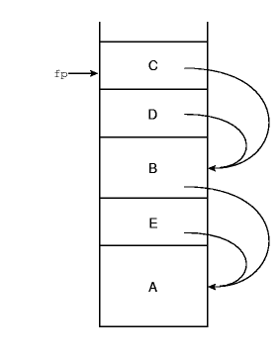
Review of Stack Layout (cont’d)
Static chain
- Each stack frame contains a reference to the lexically surrounding subroutine

Slide 61
Calling Sequences
Calling sequence: code executed by the caller immediately before and after a subroutine call
Prologue
Epilogue

Slide 62
Calling Sequences (cont’d)
Tasks on the way in (prologue)
Passing parameters, saving return address, changing program counter, changing stack pointer, saving registers, changing frame pointer
Tasks on the way out (epilogue)
Passing return parameters, executing finalization code, deallocating stack frame, restoring saved registers and pc

Slide 63
In-Line Expansion
Allows certain subroutines to be expanded in-line at the point of call
Avoids several overheads (space allocation, branch delays, maintaining static chain or display, saving and restoring registers)

Slide 64
Implementations of In-line Expansion
C++ uses keyword inline:
inline int max( … ) { … }
Ada:
pragma inline (function_name);
Pragmas make suggestions to the compiler. Compiler can ignore suggestion.

Slide 65
In-line Expansion versus Macros
in-line expansion
Semantically preferable
Disadvantages?
macros
Semantic problems
Syntactic problems
increasing code size
Generally not an option for recursive subroutines

Slide 66
Parameter Passing Basics
Parameters - arguments that control certain aspects of a subroutine’s behavior or specify the data on which they are to operate
Global Variables are other alternative
Parameters increase the level of abstraction

Slide 67
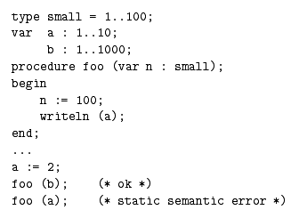
More Basics
Formal Parameters - parameter name in the subroutine declaration
Actual Parameters – values passed to a subroutine in a particular call
Pascal – to prevent from assigning an out of range value

Slide 68
Call by Value
For P(X), two options are possible: Call by Value and Call by Reference
Call by Value - provides P with a copy of X’s value
Actual parameter is assigned to the corresponding formal parameter when subroutine is called, and the two are independent from then on
Like creating a local or temporary variable

Slide 69
Call by Reference
Call by Reference – provide P with the address of X
The formal parameter refers to the same object as the actual parameter, so that changes made by one can be seen by the other

Slide 70
Language Specific Variations
Pascal: Call by Value is the default, the keyword VAR denotes Call by Reference
Fortran: all parameters passed by Reference
Smalltalk, Lisp: Actual Parameter is already a reference to the object
C: always passed by Value

Slide 71
Value vs. Reference
Pass by Value
Called routine cannot modify the Actual Parameter
Pass by Reference
Called routine can modify Actual Parameter
+safe
- Copying may be time consuming
+Only have to pass an address, efficient
-Requires an extra level of indirection

Slide 72
Generic subroutines and modules
Exception handling, Co-routines and Events.

Slide 73
Exceptions
Exceptions are an unexpected or unusual condition that arises during program execution.
Most common are various sorts of run-time errors (ex. encountering the end of a file before reading a requested value)
Examples include a user providing abnormal input, a file system error being encountered when trying to read or write a file, or a program attempting to divide by zero.

Slide 74
Handling Exceptions
Recent languages provide exception-handling facilities where handlers are lexically bound to blocks of code.
General rule is if an exception isn’t handled in the current subroutine, then the subroutine returns and exception is raised at the point of call.
Keeps propagating up dynamic chain until exception is handled.
If not handled a predefined outermost handler is invoked which will terminate the program.

Slide 75
Main Handler Uses
1) Perform some operation that allows the program to recover from the exception and continue executing.
2)If recovery isn’t possible, handler can print helpful message before termination
3)When exception occurs in block of code but can’t be handled locally, it is important to declare local handler to clean up resources and then re-raise the exception to propagate back up.

Slide 76
Exception Propagation
try{
...
//protected block of code
...
}catch(end_of_file) {
...
}catch(io_error e) {
//handler for any io_error other than end_of_file
...
}catch(…) {
//handler for any exception not previously named
//… is a valid token in the case in C++, doesn’t
//mean code has been left out.
}

Slide 77
Coroutines

Slide 78
Coroutines
Coroutines are execution contexts that exist concurrently, but execute one at a time, and transfer control to each other explicitly, by name.
They can implement iterators and threads.

Slide 79
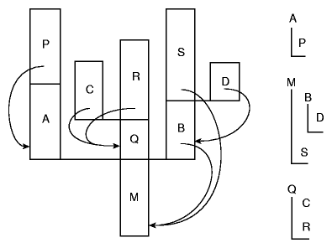
Stack Allocation
Since they are concurrent, they can’t share a single stack because subroutine calls, and returns aren’t LIFO
Instead the run-time system uses a cactus stack to allow sharing.

Slide 80
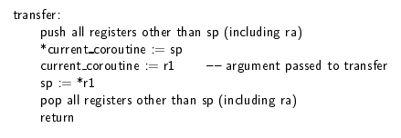
Transfer
To go from one coroutine to another the run-time system must change the PC, stack, and register contents. This is handled in the transfer operation.

Slide 81
Events
Event driven programming is the programming paradigm in the field of computer science.
In this type of programming paradigm, flow of execution is determined by the events like user clicks or other programming threads or query result from database.
Events are handled by event handlers or event callbacks.

Slide 82
Event-driven programming focuses on events.
Eventually, the flow of program depends upon events.
Event-driven programming depends upon an event loop that is always listening for the new incoming events.
The working of event-driven programming is dependent upon events.
Once an event loops, then events decide what to execute and in what order. Following flowchart will help you understand how this works −

Slide 83
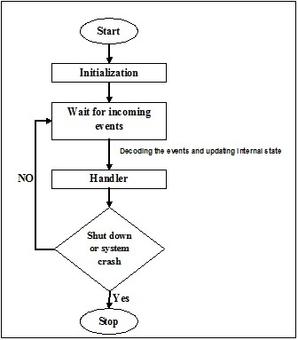

Slide 84
THANKYOU

